Slide 1

SMART DOOR LOCK
BATCH NUMBER :- 8
RAVI KUMAR 99220040181
SANJAY KUMAR 99220040190
GOPAL KUMAR 99220040063
A.LOKESH 99220040236
R .GOVINDH REDDY 99220040184
Guided by
Dr . B . Raja Krishnamoorthi

Slide 2
CONTENT
01
INTRODUCTION
02
OBJECTIVE
03
ABSTRACT
04
BLOCK DIAGRAM
05
HARDWARE
06
SOFTWARE
07
CONCLUSION

Slide 3
INTRODUCTION
A smart door lock system using an ESP32-CAM and a Telegram bot is a modern and secure way to enhance the security and convenience of your home or office. This system allows you to remotely control and monitor access to your property using a combination of hardware and software. In this introduction, we will provide an overview of the components and functionalities of such a system.

Slide 4
OBJECTIVES
A smart door lock is a technological advancement over traditional door locks, designed to provide enhanced security, convenience, and remote control capabilities. The specific features and functionalities of a smart door lock can vary depending on the manufacturer and model, but here are some common components and functionalities you might find in a smart door lock:
Remote Access: Smart door locks allow users to control and monitor their locks remotely using smartphones or other connected devices.
Keyless Entry: These locks offer keyless entry options such as PIN codes, fingerprint recognition, RFID cards, or mobile app unlocking.
Security Alerts: They can send notifications to the user's device when the door is locked or unlocked, enhancing security awareness.

Slide 5
OBJECTIVES
Integration with Smart Homes :- Many smart door locks are compatible with home automation systems, enabling integration with other smart devices like cameras, lights, and thermostats.
Remote Locking :- Users can remotely lock the door if they forgot to do so upon leaving, adding an extra layer of convenience and security.
Security Features :- Many smart locks offer advanced security features like tamper alerts, auto-locking, and encryption to protect against unauthorized access and hacking

Slide 6
ABSTRACT
A smart door lock system is like a super-smart version of a regular lock on your door. Instead of using a physical key, you can control it with your phone or even your voice. It keeps your home safe and lets you decide who can come in and when. You can also check if your door is locked when you're not home and even give temporary access to friends or delivery people. It's like having a super secure and convenient lock that you can control with technology.

Slide 7
FLOW DIAGRAM
WIFI Router
Internet
Smart phone
ESP32-CAM
Camera
Door lock

Slide 8
HOW IT WORK
1. When you send a command to the Telegram bot, it forwards the request to the ESP32-CAM over the internet.
2. The ESP32-CAM processes the command and controls the door lock mechanism accordingly.
3. If the person will click the switch button , it can capture images or videos of the person requesting access and send them back to you via the Telegram bot.
4. Access logs and alerts are generated and can be accessed through the Telegram bot, providing you with a comprehensive overview of the system's activity.

Slide 9
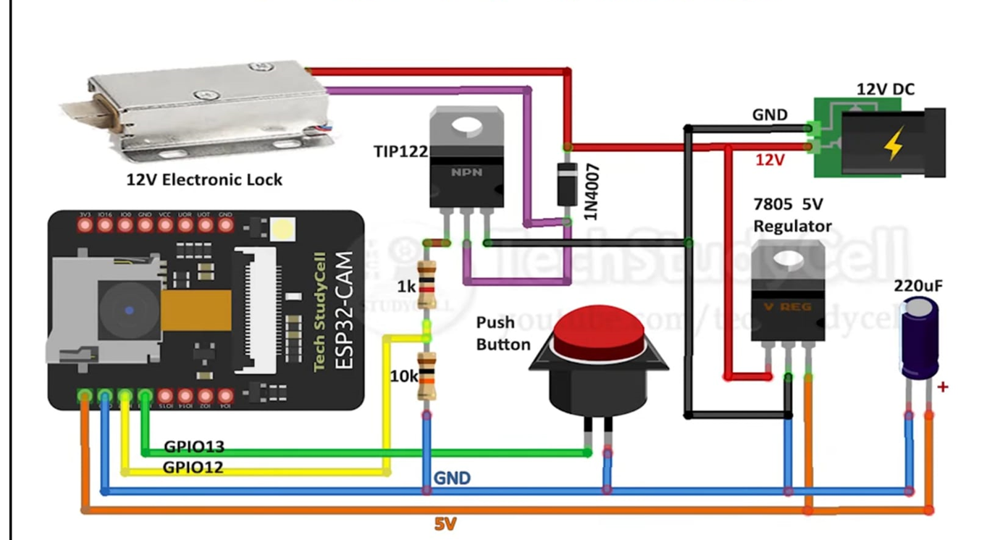
CIRCUIT DIAGRAM

Slide 10
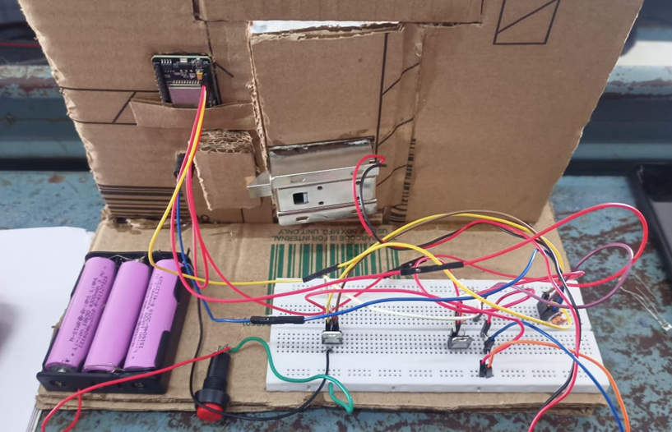
CIRCUIT DIAGRAM

Slide 11
HARDWARE COMPONENT
01
Arduino uno
02
ESP32-CAM board
03
12V Electronic Lock
04
TIP122 NPN Transistor
05
7805 5V regulator
06
1k & 10k Resistors
07
1N4007 diode
08
Push Switch
09
12V DC supply

Slide 12
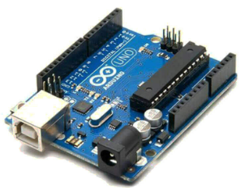
ARDUINO
UNO
The Arduino Uno is an open-source microcontroller board based on the Microchip ATmega328P microcontroller and developed by Arduino.cc and initially released in 2010.
Availability: Uno R3 webpage
CPU: Microchip AVR (8-bit); at 16 MHz
Developer: arduino.cc
Manufacturer: Many
Memory: 2 KB SRAM
Storage: 32 KB Flash; 1 KB EEPROM
It has 14 digital input/output pins (of which 6 can be used as PWM outputs), 6 analog inputs, a 16 MHz ceramic resonator, a USB connection, a power jack, an ICSP header and a reset button.

Slide 13
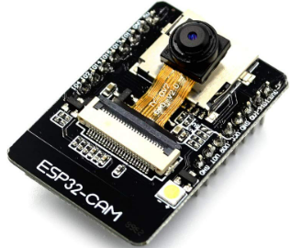
ESP 32 CAM
The ESP32-CAM is a compact development board that combines the power of the ESP32 microcontroller and a camera module, making it a versatile platform for various Internet of Things (IoT) and DIY projects involving image and video processing
The ESP32-CAM has the following features:
WiFi, Bluetooth, and low power BLE
2 high-performance 32-bit LX6 CPUs
2MP video camera
microSD card
On-board antenna
IPEX connector for an external antenna
On-board reset button
Built-in LED flash lamp
Dual-core processor
Onboard RAM and program storage
External micro SD slot for expansion
Wireless radio for Wi-Fi and Bluetooth

Slide 14
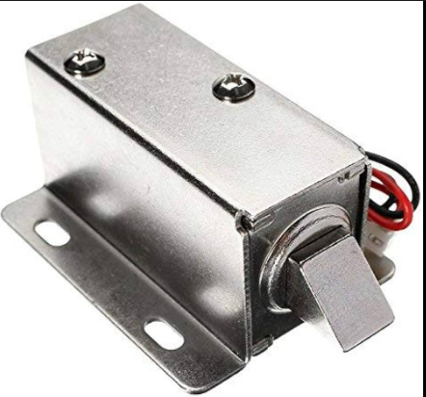
12V Electronic Lock
A solenoid lock, also known as an electric solenoid lock, is an electromechanical device designed to control the locking and unlocking of doors, gates, cabinets, or other physical barriers. It operates based on the principles of electromagnetic attraction and can be found in a variety of applications, from access control systems to industrial machinery.

Slide 15
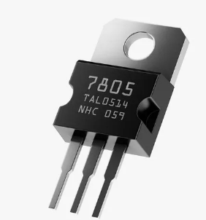
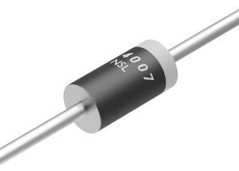
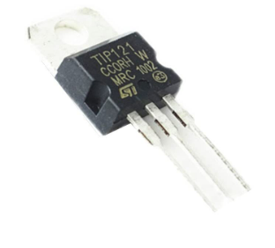
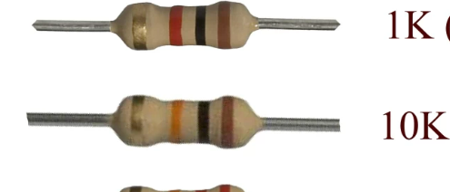
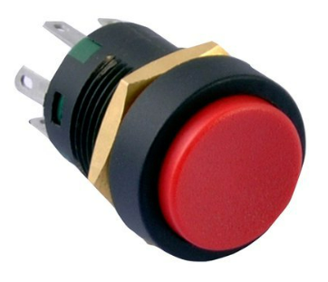
7805 5V regulator
7805 5V regulator :-The 7805 is a fixed voltage regulator, which means that it provides a constant output voltage of 5V.
TIP122 NPN Transistor :- designed for standard amplification and low speed switching submissions.
1N4007 diode
TIP122 NPN Transistor
1k & 10k Resistors
1N4007 diode :- convert alternating current to direct current.
Resister :- Resistor is used to resistance the flow of current
Push Switch
Push Switch :- to control an electrical circuit in which the operator manually presses a button to actuate an internal switching mechanism

Slide 16
SOFTWARE
01
ARDUINO IDE 1.8.10
03
C++

Slide 17

ARDUINO IDE
1.8.10
The Arduino IDE (Integrated Development Environment) is open-source software that allows users to write and upload code to Arduino boards. It supports the programming languages C and C++. The IDE is suitable for different operating systems such as Windows, Mac OS X, and Linux.

Slide 18

C++
C++ is a high-level, general-purpose programming language created by Danish computer scientist Bjarne Stroustrup.

Slide 19
CONCLUSION
In conclusion, the smart door lock system, built using an ESP32-CAM and integrated with a Telegram bot, provides a convenient and secure way to control access to your property. This system combines the power of IoT technology with instant communication through Telegram, enhancing the overall safety and convenience of your home or office.

Slide 20
REFERENCE
References for smart door lock systems can be a great source of information and guidance for designing and implementing such systems. Here are some academic papers and resources related to smart door locks:
1. "A Smart Door Lock System for the Internet of Things with Improved Security"
- Author: Yohan Noh, et al.
- Published in: IEEE Transactions on Consumer Electronics, 2015.
- This paper discusses a smart door lock system for the Internet of Things (IoT) and focuses on improving its security.
4. "Smart Door Lock System for Smart Home Security Using IoT"
- Author: Samina Shaheen, et al.
- Published in: 2020 IEEE International Conference on Informatics, IoT, and Enabling Technologies (ICIoT).
- This paper explores a smart door lock system for smart home security, integrating it with the Internet of Things (IoT).
These references cover a range of topics related to smart door lock systems, including security, authentication methods, and IoT integration. You can explore these papers to gain a deeper understanding of the subject and find relevant information for your own smart door lock project.

Slide 21

THANK YOU

